Slide 1

Opinion dynamics models in empirically justified networks
Joel Wildman

Slide 2
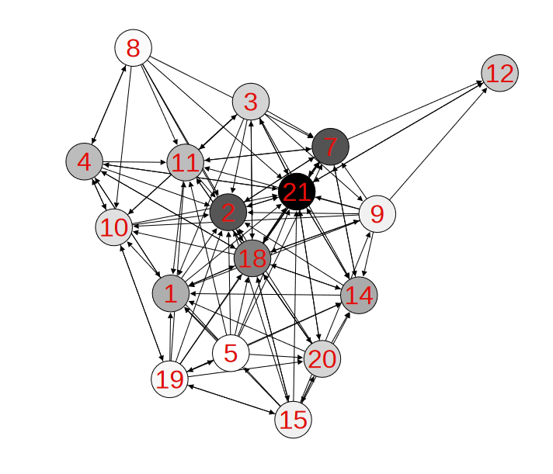
An introduction to social modelling
What are Social Networks?
What are Opinion Dynamics Models?
How can we improve them?
Problem statement
Reduced Krackhardt’s advice network
with 17 nodes, Jia, P., MirTabatabaei, A., Friedkin, N. E., & Bullo, F. (2015). Opinion dynamics and the evolution of social power in influence networks. SIAM review, 57(3), 367-397.

Slide 3
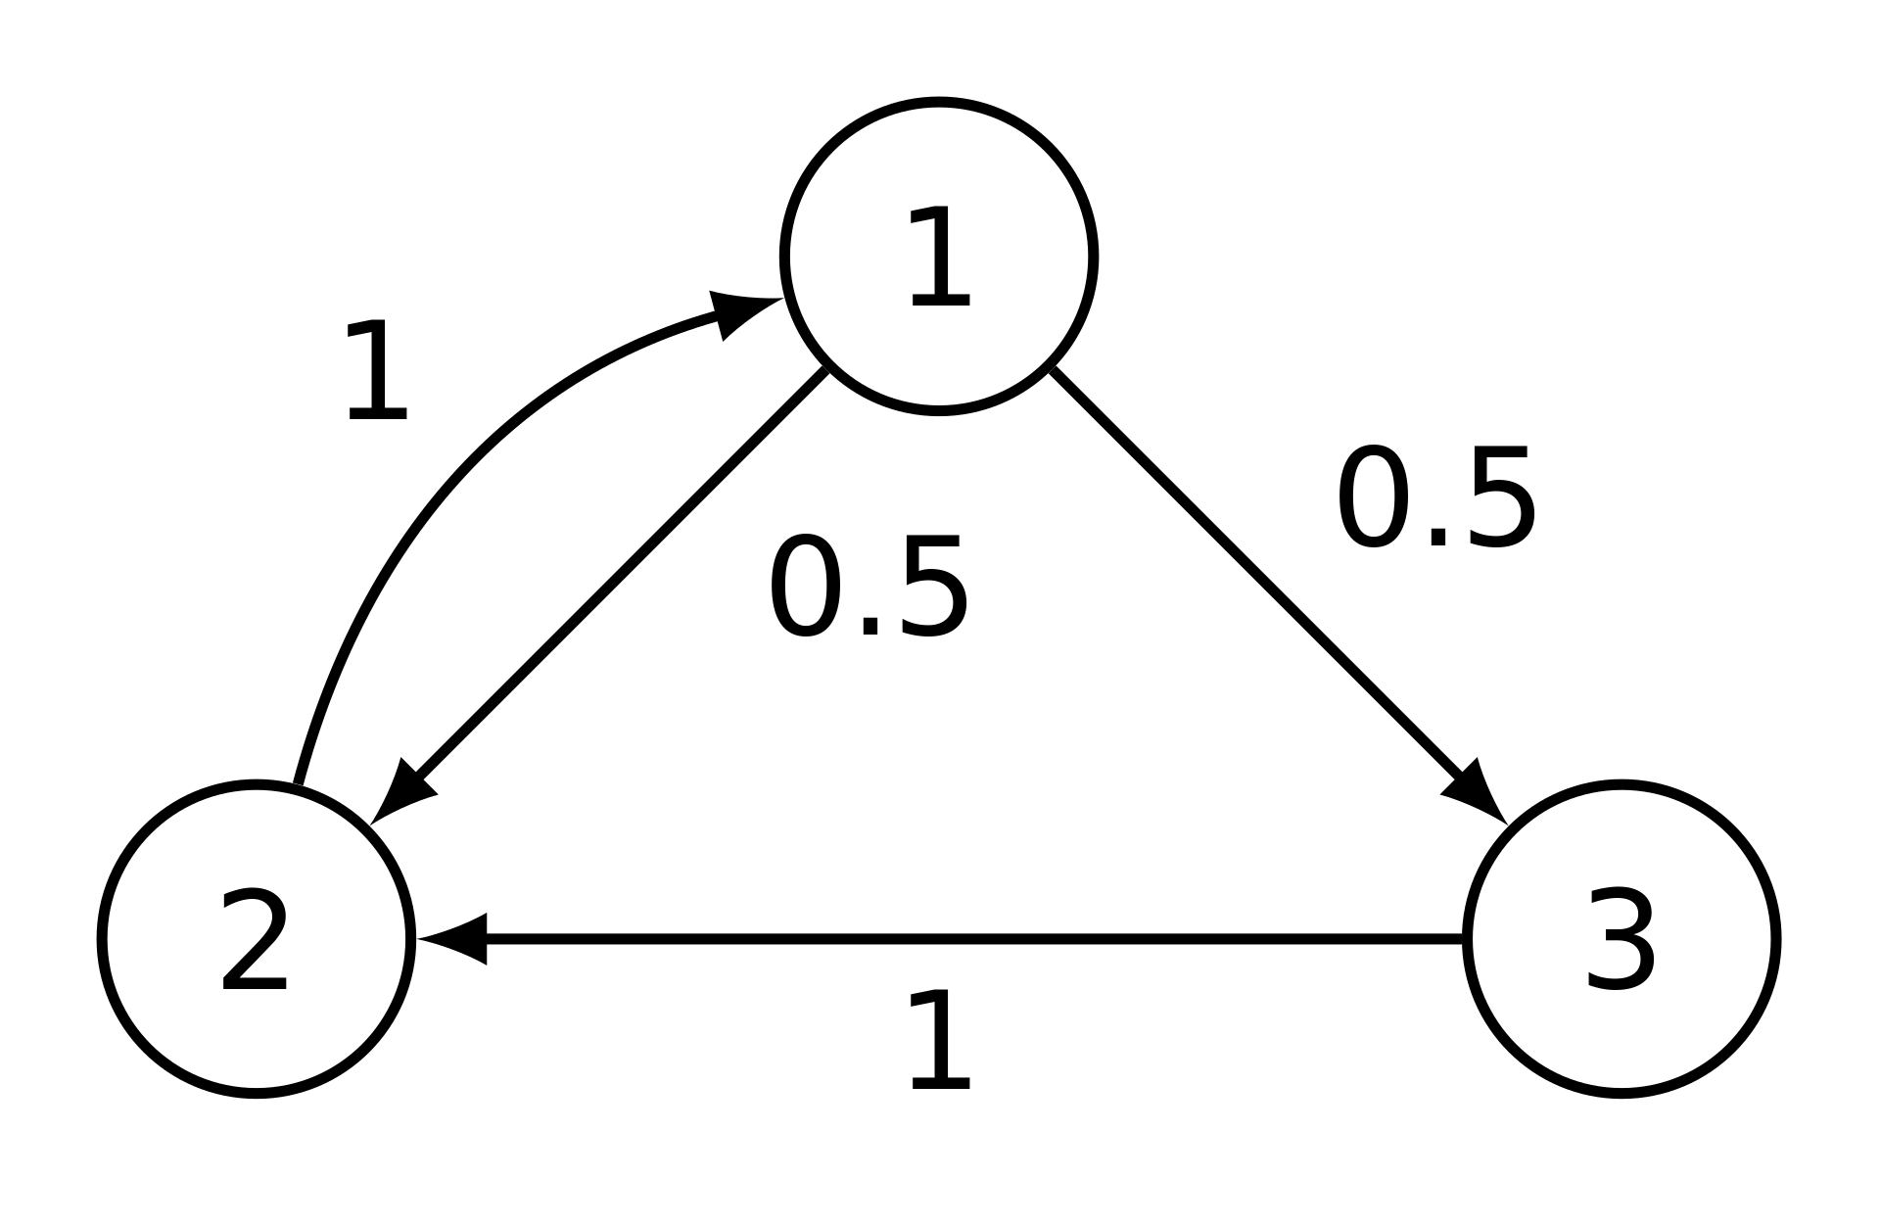
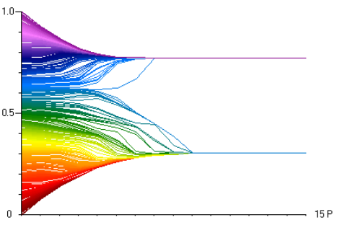
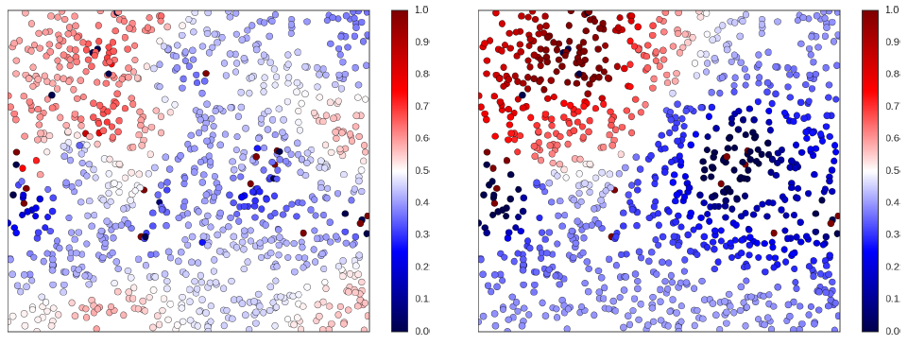
Existing Models
Older Models
Mathematically oriented
Advent of computer simulation
Modern models
Example of convergent network in the DeGroot Model
Hegselmann-Krause bounded confidence model
Rainer, H., & Krause, U. (2002). Opinion dynamics and bounded confidence: models, analysis and simulation.
Peter Duggins’ social influence model environment
Duggins, P. (2014). A psychologically-motivated model of opinion change with applications to American politics. arXiv preprint arXiv:1406.7770.
Notes:
Old models:
well defined by mathematical functions
often exhibited simple behaviour
homogenous agents
linear functions
New models:
driven by simulation
heterogeneous models and persistently complex behaviour
Characteristics of real opinions:
(a) diversity of opinions across society, (b) opinion subcultures, and (c) pluralistic ignoranc

Slide 4
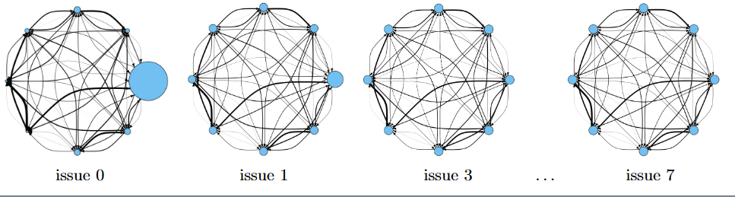
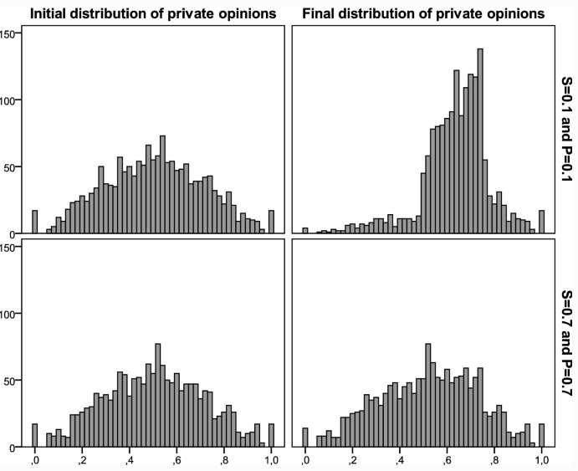
Which are right for us?
DeGroot-Friedkin model
Mathematical basis
Preference Falsification Simulation model
Psychologically driven, complex system
Jia, P., MirTabatabaei, A., Friedkin, N. E., & Bullo, F. (2015). Opinion dynamics and the evolution of social power in influence networks. SIAM review, 57(3), 367-397.
VS
León-Medina, F. J., Tena-Sánchez, J., & Miguel, F. J. (2020). Fakers becoming believers: how opinion dynamics are shaped by preference falsification, impression management and coherence heuristics. Quality & Quantity, 54(2), 385-412.

Slide 5
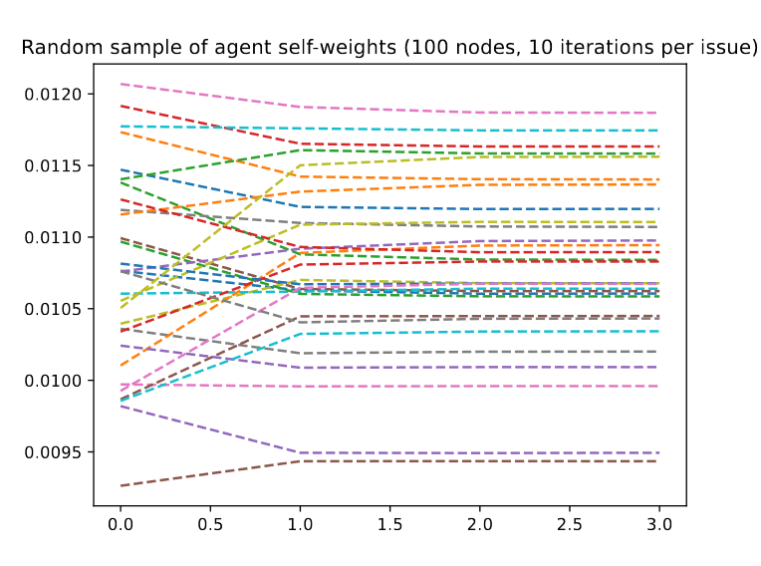
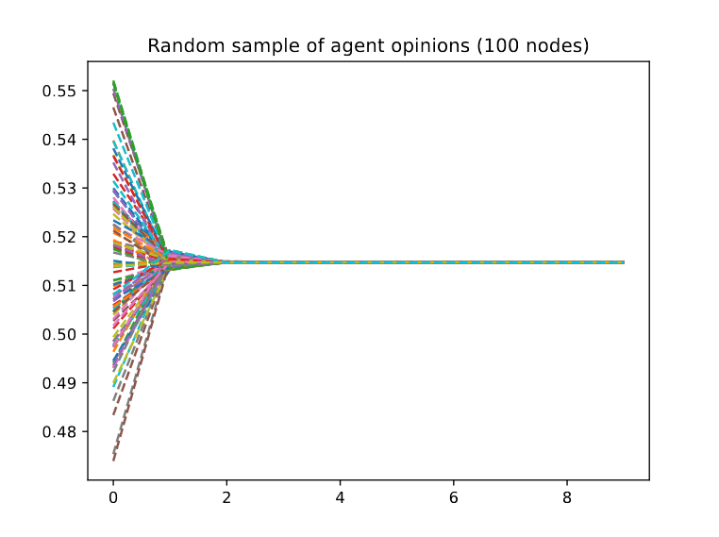
DeGroot-Friedkin model overview
General principle
Update rules
Environment
Issue
Opinion
DGF self weights over 10 issues, 100 node complete graph
Iteration
DGF opinions over 10 issues, 100 node complete graph

Slide 6
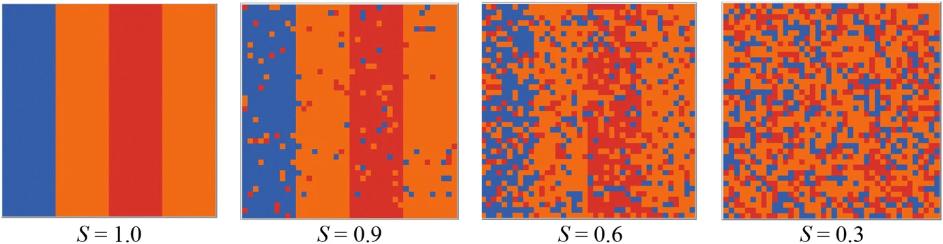
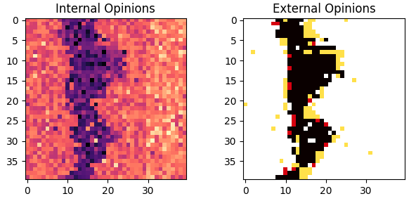
Preference Falsification Simulation model
Guiding principles
Update rules
Environment
Class distribution across segregation levels.
Internal and External opinion distributions after 30 iterations

Slide 7
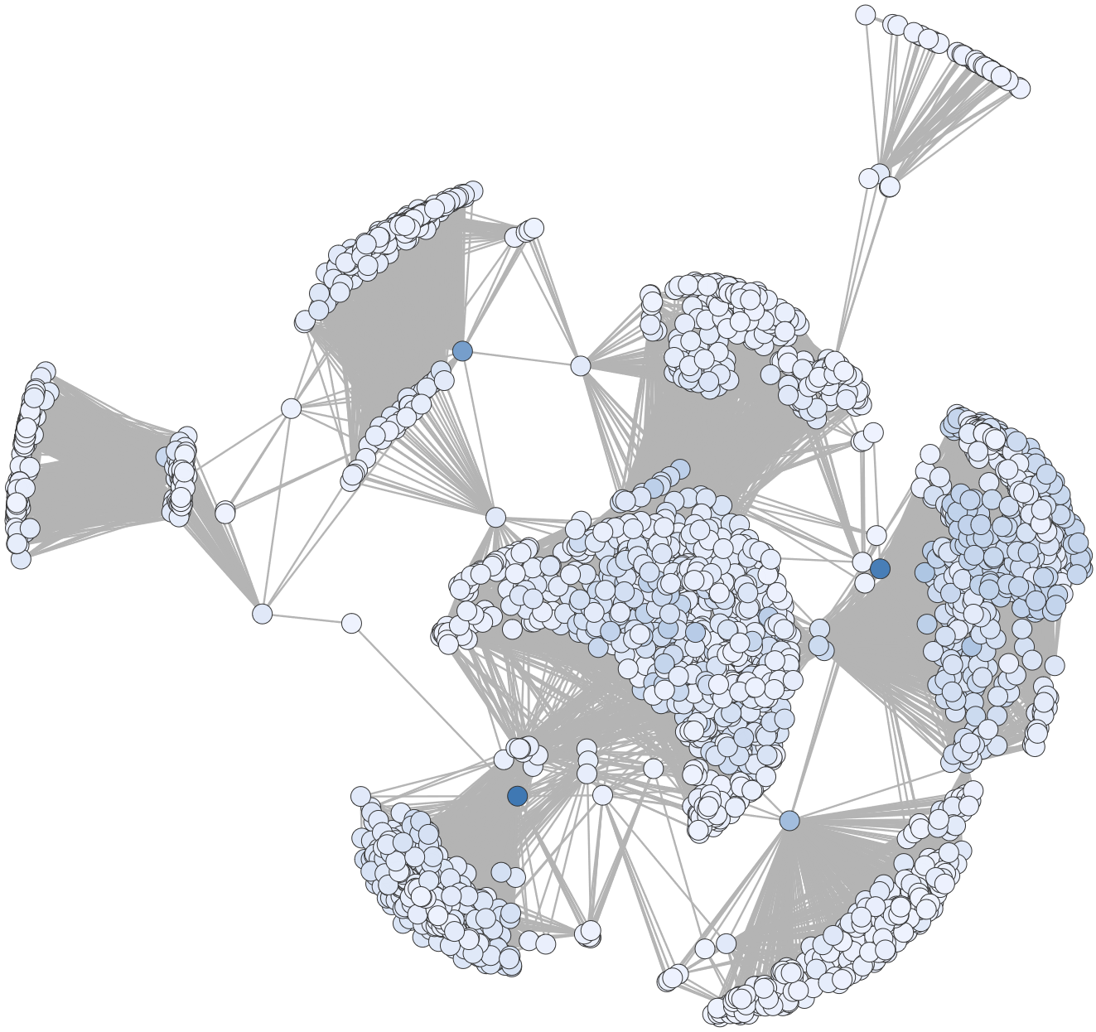
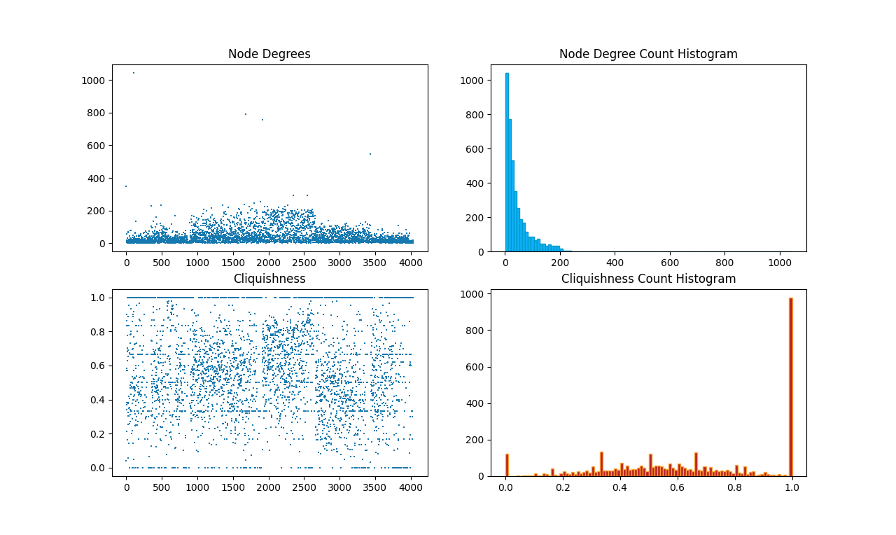
The Facebook Dataset
SNAP origins
Network details?
Network characteristics?
Why does this represent an actual social network?
Notes:
Stanford network analysis project
Cliquishness: define
Degree: ~44, stdev of 25, median of 52

Slide 8
Modifications to the Models
DGF on complete directed graphs
Facebook undirected graph to directed graph
Arbitrary weights (discussed later)

Slide 9
Modifications to the Models
PFS model environment breakdown
A grid as an 8-regular graph
Neighbourhoods with DFS

Slide 10
Modifications to the Models
PFS internal vs external ??

Slide 11
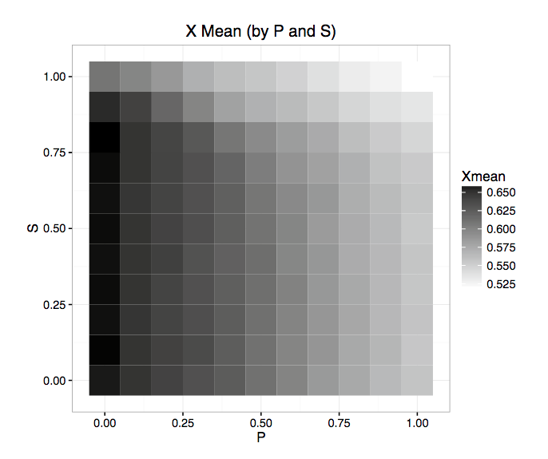
Simulation

Slide 12
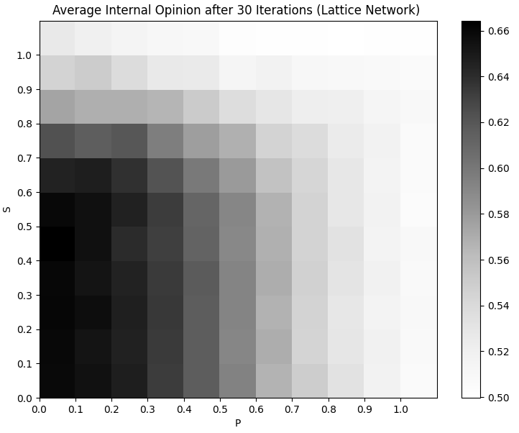
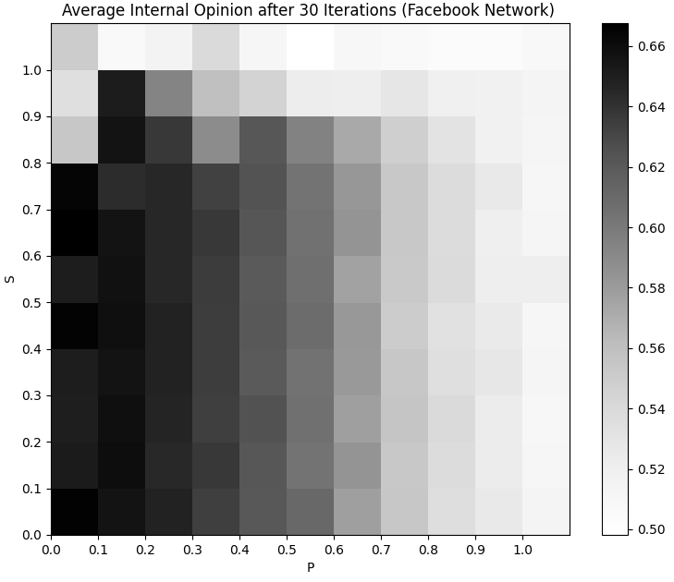
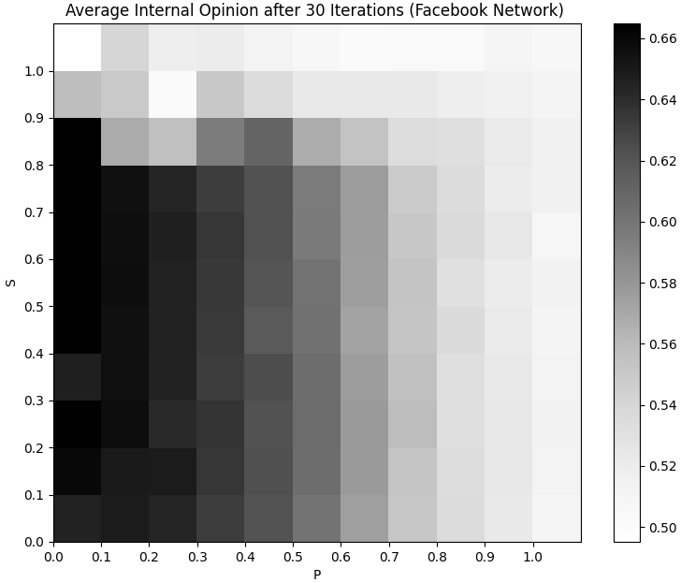
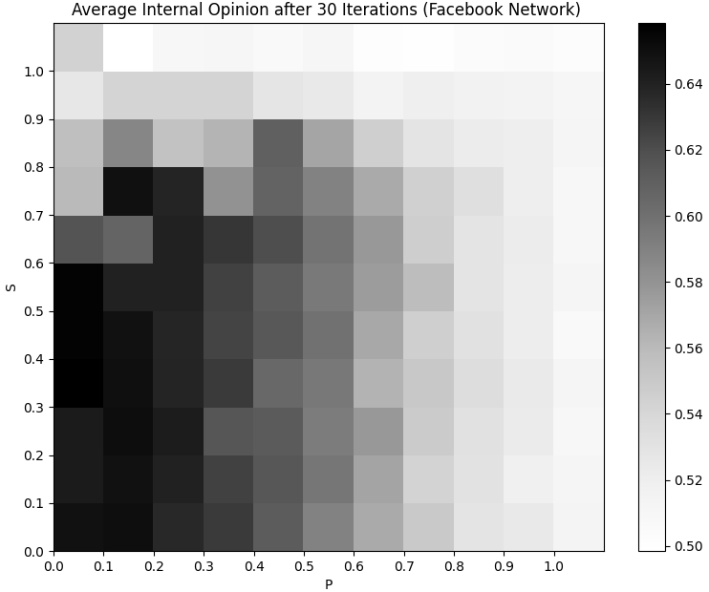
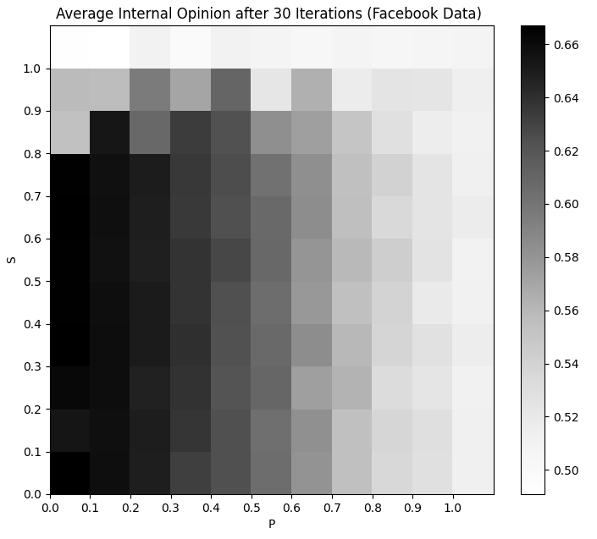
PFS Results
Lattice
70% of edges
(x̄ degree: 30)
50% of edges
(x̄ degree: 21)
30% of edges
(x̄ degree: 13)
Facebook
Notes:
Note on iteration counts

Slide 13
DGF Results
Notes:
Note on iteration counts

Slide 14
Discussion
Minor changes in outcome but no novel mechanics
Connectivity as the driving factor
Future research
Notes:
Future discussion:
influence networks
more models
more network characteristic studies

